Slide 1
Gaiza – Discord Bot
A project by Cain Kaltenbaugh

Slide 2
Motivation
Previous project created in Node.js
Current user of the platform
Interested in learning new ways to solve problems

Slide 3
Outline
Vocabulary
Bot Basics
User Commands
Admin Commands
Listeners
Internal Structure
Summary
Conclusion
Future Work

Slide 4
Vocabulary
API: Application programming interface
JavaCord: Multithreaded library
Discord Bot: Range of functionalities depending on the directive
Listener: Actively waits for a specified input
Commands: User invoked methods
Embed: Multipart message with multiple properties

Slide 5
Bot Basics
Bots must be invited to a server
Privileges for the bot must be given for certain functionality
Getting the initial commands

Slide 6
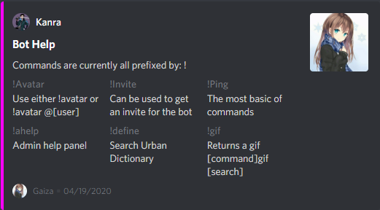
User Commands
Any user can use these commands
All include error handling
Menus to help

Slide 7
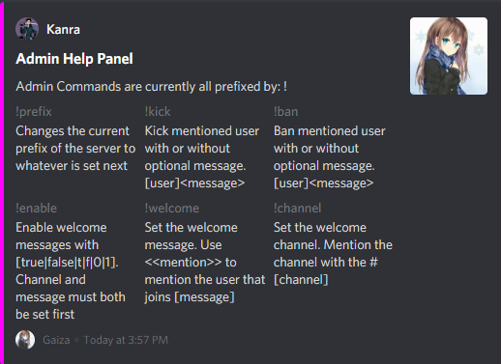
Admin Commands
Anyone with permission level of admin or owner may use these
More invasive commands
Can manage the server setup

Slide 8
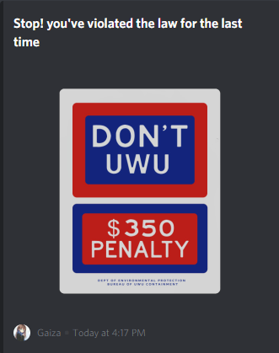
Listeners
Wait for a response before giving output
Are user ended and anyone can call it
Not intended to be called purposefully

Slide 9
Internal Structure
Distributed storage for servers
Information is on a server by server basis
No outside access from other servers

Slide 10
Summary
Bot utilizing JavaCord library
Multiple commands and listeners for users and admins
Independent server information

Slide 11
Conclusion
Utilization of the API allows for easy solutions
Useful for management of a Discord server
Introduces fun commands for users

Slide 12
Future Work
User data storage in progress
Move to Gradle to use voice capabilities
More management and game commands

Slide 13
Bibliography
https://github.com/Javacord/Javacord
https://discordapp.com/developers/docs/intro
https://discordapp.com/
https://discordjs.guide/popular-topics/embeds.html
https://github.com/IKanraI/Gaiza

